Slide 1

Market Trend Analysis using ML
Tulsi Dubey (22106055)
Sidra Khan (22106028)
Saif Khan (22106072)
Project Guide
Prof. Shraddha Dalvi

Slide 2
Outline
Introduction
Literature Survey of the Existing Systems
Limitations of the Existing Systems
Problem Statement
Proposed System Design
Framework/Algorithm
Technologies Stack for Proposed System
Details of Database / Input to the System
Implementation(Partial)
Conclusion
References

Slide 3
Accurately predicting market trends is difficult due to market volatility
and complexity.
Often fail to account for dynamic and non-linear financial data patterns.
Market Trend Analysis with Machine Learning
Need for advanced models to handle real-time data and adapt to rapid
market changes.
Improve market trend forecast accuracy using machine learning
techniques.
Covers problem, motivation, objectives, methodology, and findings. `
Introduction

Slide 4
Literature Survey of the existing system
1. Stock Market Prediction Using Machine Learning
This research applies machine learning algorithms to predict stock prices, focusing on data preprocessing, feature engineering, and model evaluation. It measures model performance using MSE, RMSE, and MAPE, and provides insights into the strengths and limitations of machine learning in stock price prediction.[2]
2. Stock Market using Machine Learning and Sentiment Analysis
This research uses sentiment analysis and machine learning to study the relationship between investor emotions and stock market trends in the Casablanca Stock Exchange Market, analyzing data from various sources to infer sentiments and predict stock evolution, combining concepts from behavioral finance, big data, and stock market news[5]..

Slide 5
Literature Survey of the existing system
3. Deep Learning Approach for Short-Term Stock Trends Prediction
This research proposes a novel framework to predict stock price directions using financial news and a sentiment dictionary, introducing a two-stream gated recurrent unit network and Stock2Vec, a sentiment word embedding trained on financial news datasets, outperforming state-of-the-art models and demonstrating effectiveness in the stock sector.[1]
4. Integrated Long-Term Stock Selection Model
This paper proposes an integrated stock selection model that combines feature selection algorithms and nonlinear machine learning methods to predict long-term stock price trends, outperforming classical linear models, and finds that the random forest algorithm performs best for both feature selection and prediction, validated through a long-short portfolio construction[4].
5. A Decade Survey on Methodologies, Recent Developments, and Future Directions
This study reviews the advancements in machine learning-based approaches for stock market prediction, analyzing findings from 2011-2021, and provides a generic framework for emerging researchers to understand the basics and advancements in this field, highlighting the potential of text data analytics and ensemble methods for improving prediction accuracies.[3]

Slide 6
Limitations of Existing Systems
1. Despite advancements, existing systems for market trend prediction still face key challenges.
2. Traditional methods often miss complex market patterns, leading to accuracy issues and poor adaptability to real-time data.
3. Machine learning models, while more sophisticated, struggle with overfitting, data dependency, and interpretability. The problem is not fully solved, but hybrid models combining statistical methods and machine learning show promise.

Slide 7
Problem statement
Develop a robust machine learning model that accurately predicts market trends in volatile conditions, overcoming traditional method limitations and addressing issues of overfitting, data dependency, and lack of real-time adaptability.

Slide 8
Proposed System Design
Data Collection:
Collects real-time and historical market data, news, and social media trends.
Data Preprocessing:
Pandas, Numpy. Matplotlib Cleans and normalizes data for analysis.
Feature Extraction:
Feature engineering, sentiment analysis. Extracts key indicators and market sentiment.
Machine Learning Model:
TensorFlow, Scikit-learn. Uses an ensemble of neural networks and decision trees for predictions.
Prediction Module:
Model inference pipelines. Generates real-time market trend predictions.
Key Modifications
Enhanced real-time adaptability and explainability through AI.
Integrated social media sentiment for a comprehensive market view.
Justification
Ensemble models improve accuracy and robustness.
Explainable AI boosts user trust, validated by research.

Slide 9
Framework/Algorithm
Framework Overview:
Stages: Data collection, preprocessing,
Tools: matplotlib,Pandas, Numpy.
Proposed Changes:
Customization: Focus on handling market volatility and improving
prediction relevance.
Value Addition: Adaptive system with interpretable results,
enhancing current solutions.

Slide 10

Technology Stack for Proposed System
Development Environment: Jupyter Notebook
Data Collection: APIs, Web Scraping (Python)
Preprocessing: Pandas, Numpy (Python)
Model Training: TensorFlow, Scikit-learn (Neural Networks, Decision Trees)
Prediction: Model Inference (Python, TensorFlow)

Slide 11
Details of Database / Input to the System
Dataset Description:
The system uses a CSV dataset containing historical market
data and relevant financial indicators.
The dataset includes fields such as date, stock prices, volume,
and technical indicators.
Tool Used:
Pandas in Jupyter Notebook.
The CSV file is uploaded directly into Jupyter Notebook using
Pandas for further processing.

Slide 12
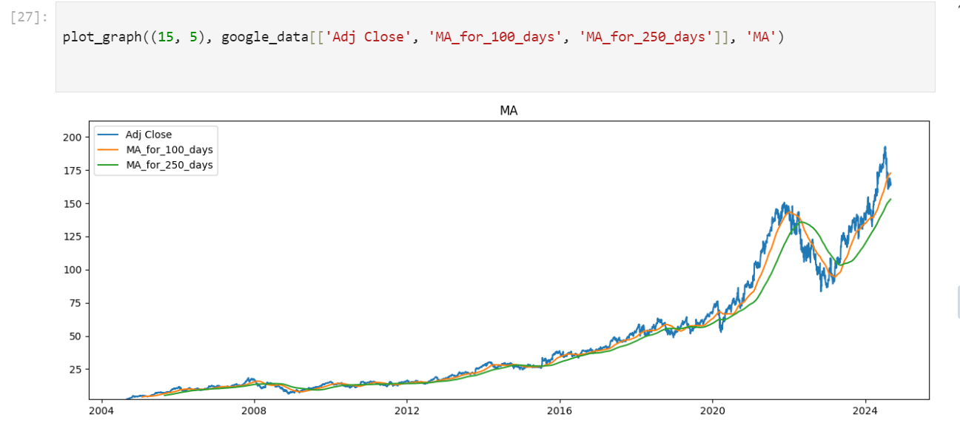
Implementation(Screenshots of implementation : 50%)

Slide 13
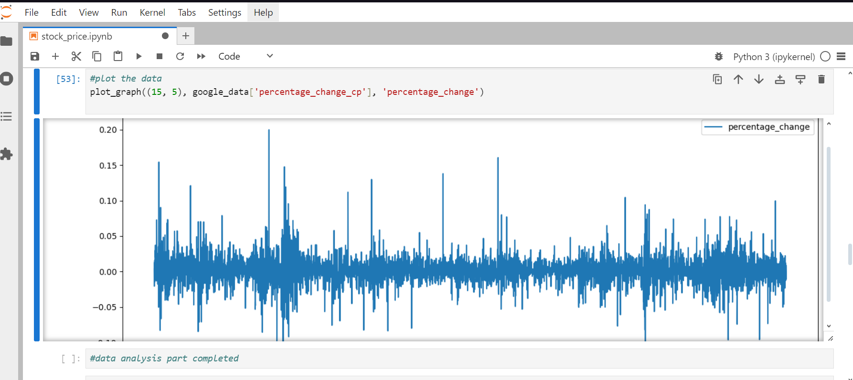
Implementation(Screenshots of implementation : 50%)

Slide 14
Conclusion
The "Market Trend Analysis with Machine Learning" project uses machine learning to forecast stock market trends and guide investment decisions. It applies algorithms like regression and time series forecasting on historical data to predict future price movements, aiming for improved prediction accuracy and real-time analysis. Future work will refine models and expand datasets.

Slide 15
References
[Zhang, Y., Li, J., & Liu, H. Deep Learning for Stock Price Prediction: A Survey, IEEE Transactions on Neural Networks and Learning Systems, vol. 35, no. 2, pp. 490-505, 2024. Link to paper]
[Patel, J., & Patel, H. Forecasting Stock Prices with Ensemble Machine Learning Models, Springer Journal of Financial Data Science, vol. 12, no. 3, pp. 230-245, 2022. Link to paper]
[Abhinay Yadav, Vineet Kumar, Satyendra Singh, Ashish Kumar Mishra,"A Novel Approach for Forecasting Price of Stock Market using Machine Learning Techniques", Volume 5,2024, 12383.pdf (ijfmr.com)]
[Jinan Zou, Qingying Zhao, Yang Jiao, Haiyao Cao, Yanxi Liu,"Stock Market Prediction via Deep Learning Techniques: A Survey", arXiv, 2022 , [2212.12717] Stock Market Prediction via Deep Learning Techniques: A Survey (arxiv.org)]
["Analyzing Moroccan Stock Market using Machine Learning and Sentiment Analysis”, IEEE Xplore, 2020]

Slide 16
Thank You...!!

